Slide 1
Summary master Christmas 2020
Ivar Svalheim Haugerud

Slide 2
Three main topics
Reciprocal relation
Effective diffusion in channel with periodic discontinuous wall roughness
Effective diffusion in oscillating flow with periodic sinusoidal wall perturbation

Slide 3
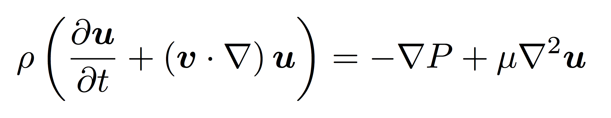
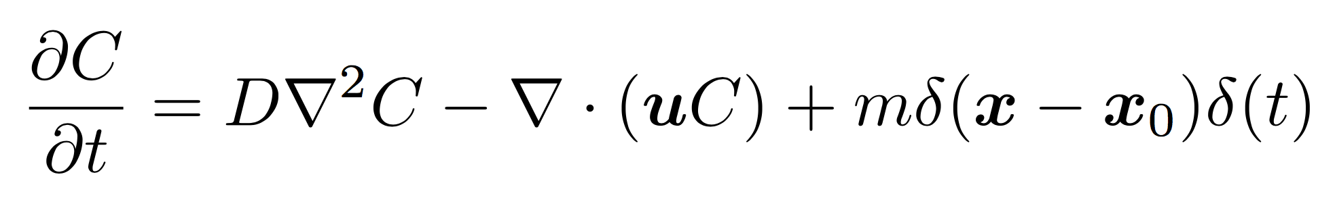
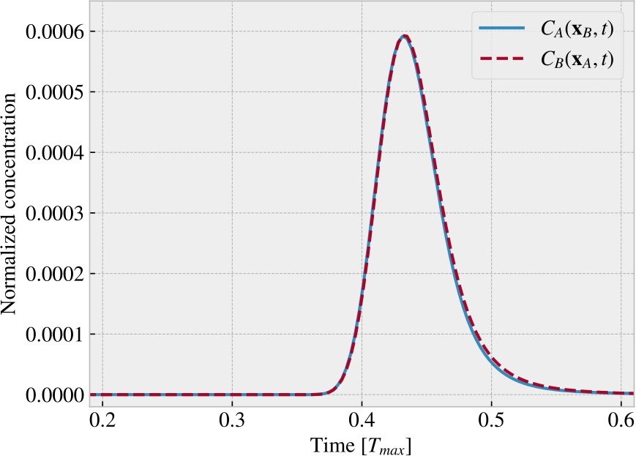
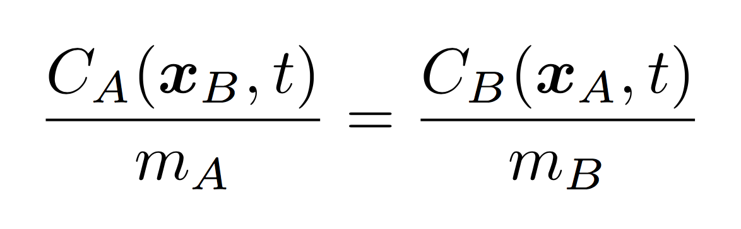
Reciprocal relation
Lattice-Boltzmann
Analytic advection-diffusion-equation

Slide 4
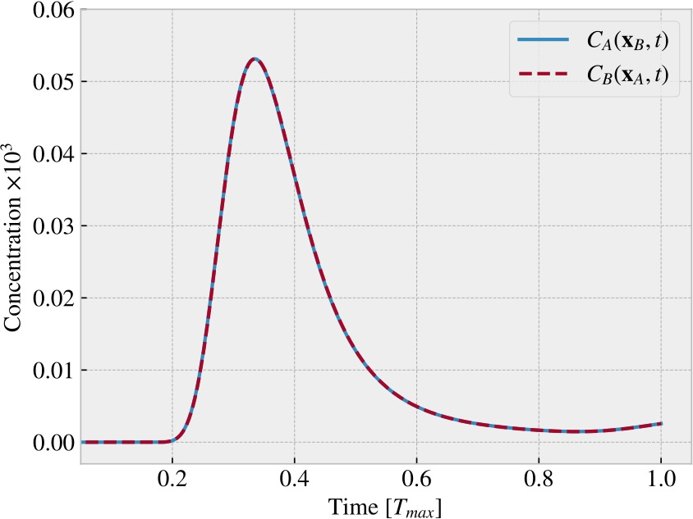
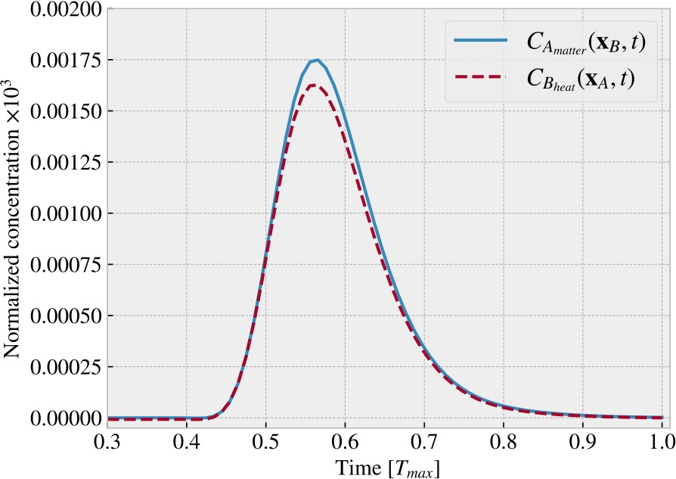
Thermal diffusion
Heat both ways: Re = 3.8*1e-4, Pe = 9.7
Heat one way, matter the other:
Re = 2.4*1e-3, Pe = 60.3.
Differenet boundary conditions, heat not conserved

Slide 5
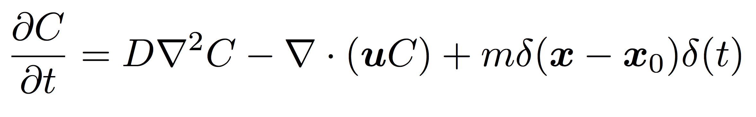
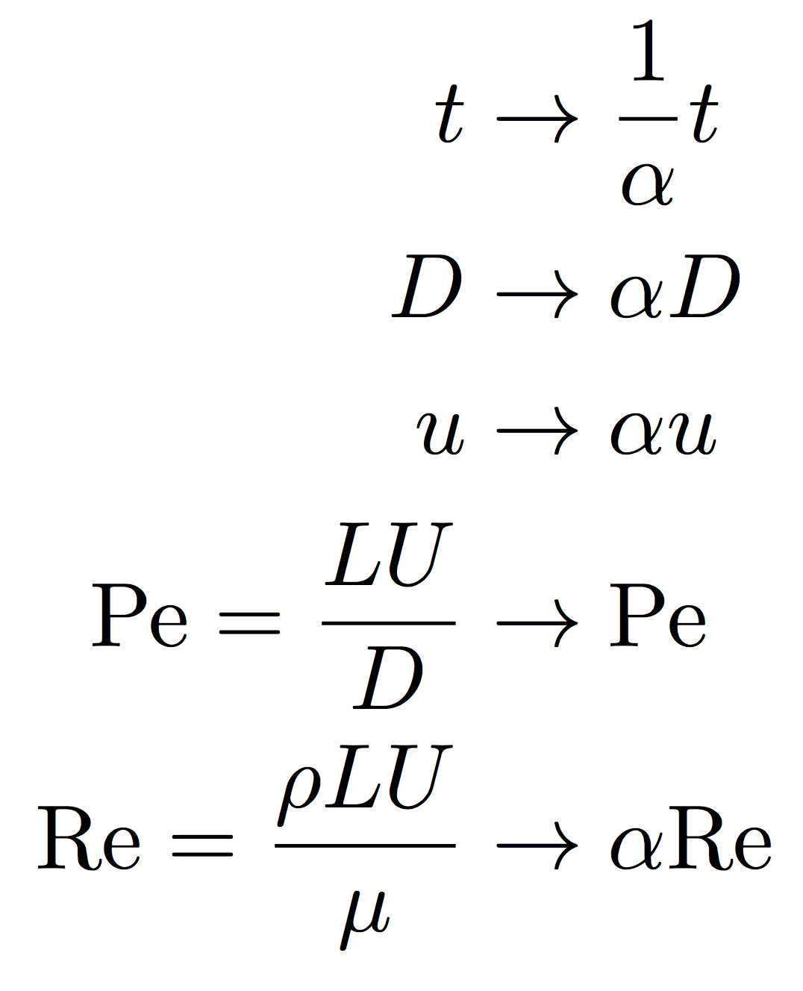
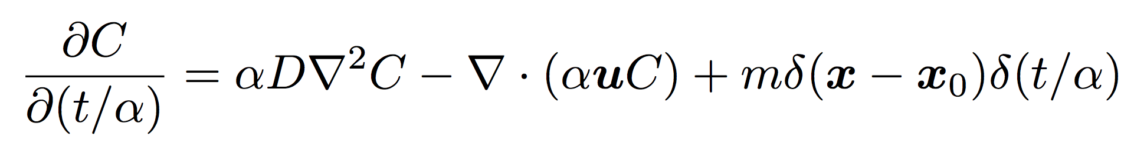
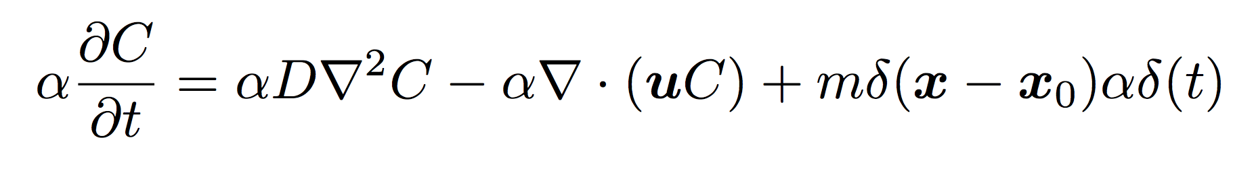
Constant Peclet number

Slide 6
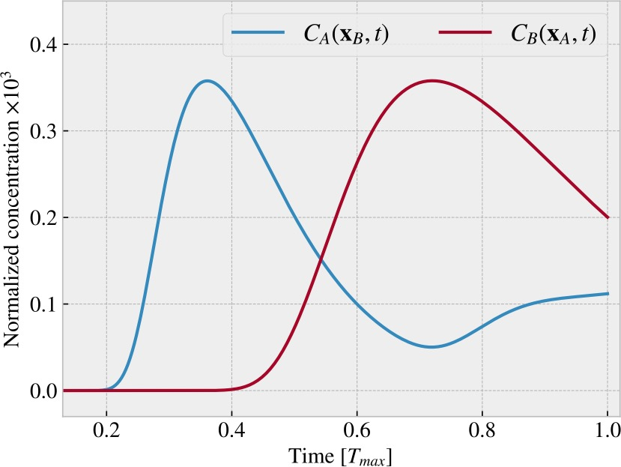
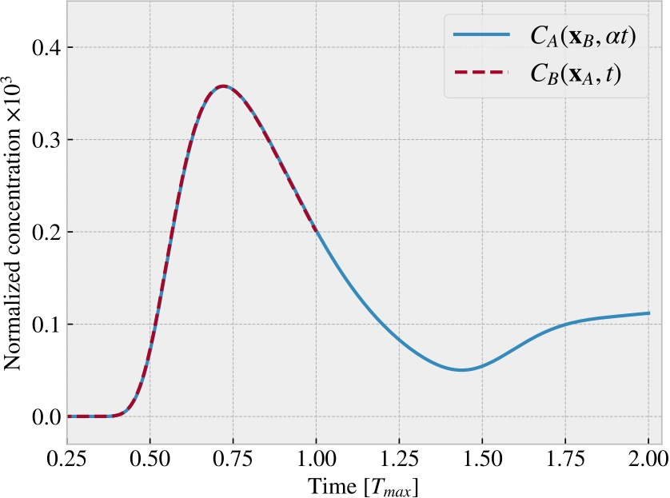
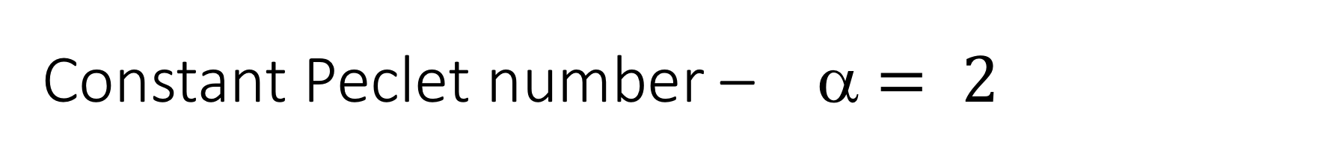
Constant Peclet number – α $= 2$

Slide 7
Maximizing concentration

Slide 8
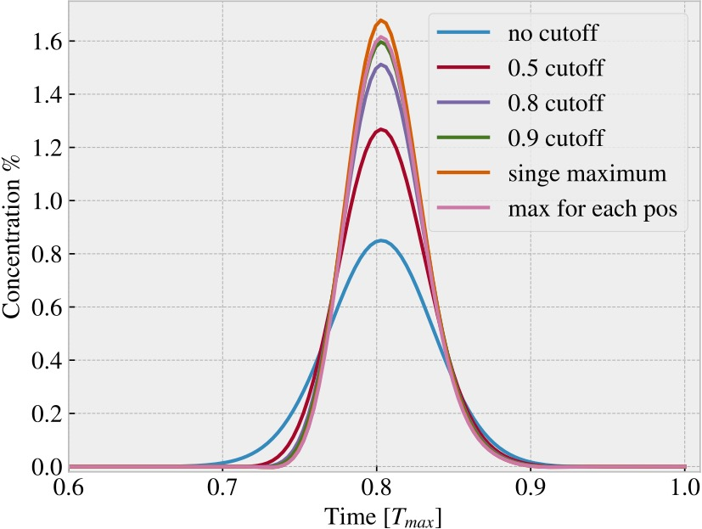
Maximizing concentration

Slide 9
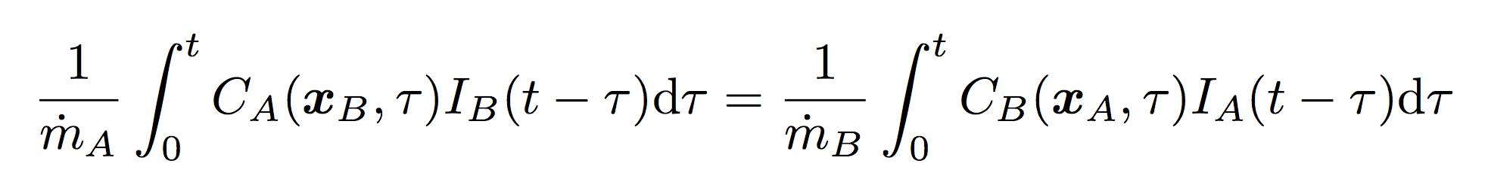
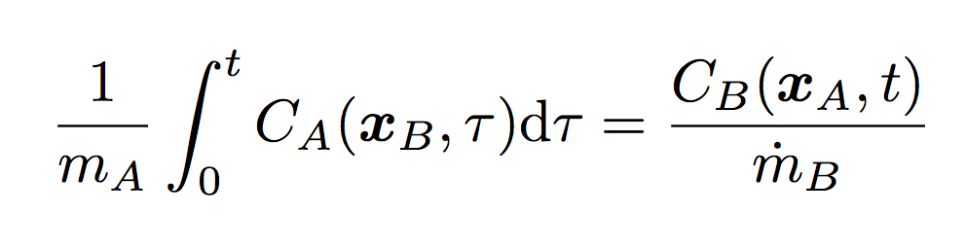
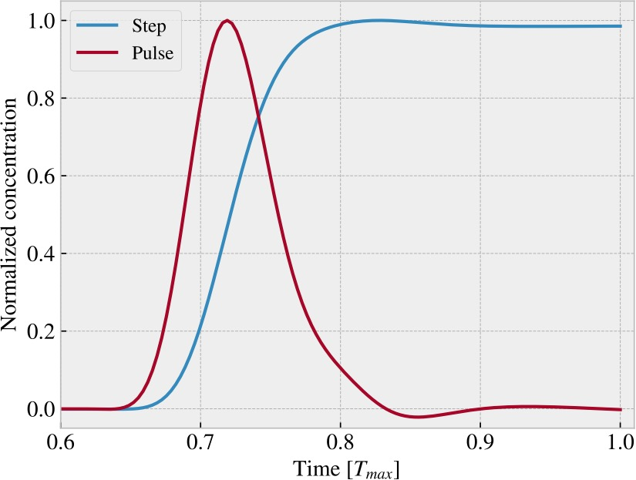
General injection

Slide 10
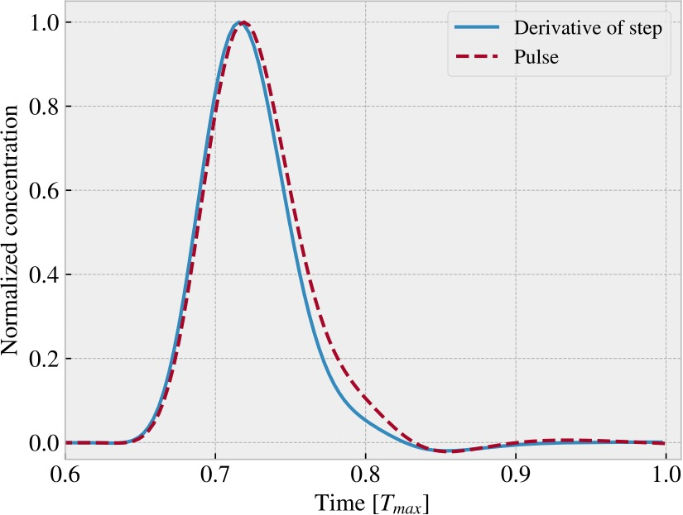
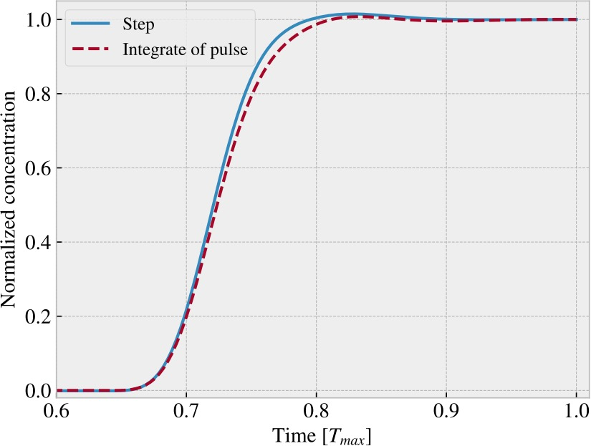
Heaviside step function injection
Re = 6.9 * 1e-3

Slide 11
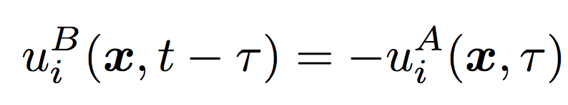
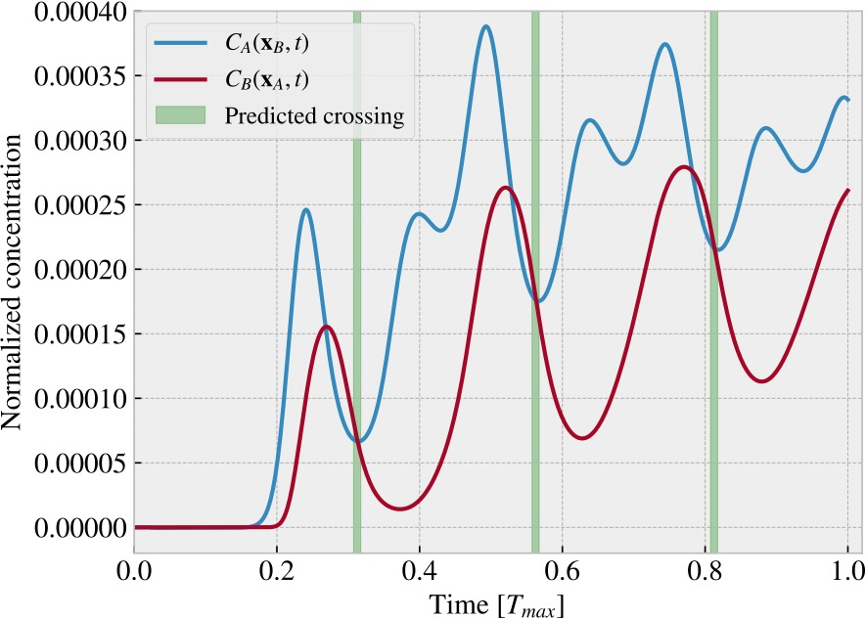
Time dependent flows

Slide 12
Veien videre
Er noe av dette interessant?
Hvordan forskjellen avhenger av Peclet for varme vs materie
Hvordan krysningen avhenger av Re, siden NS fortsatt er lineær

Slide 13
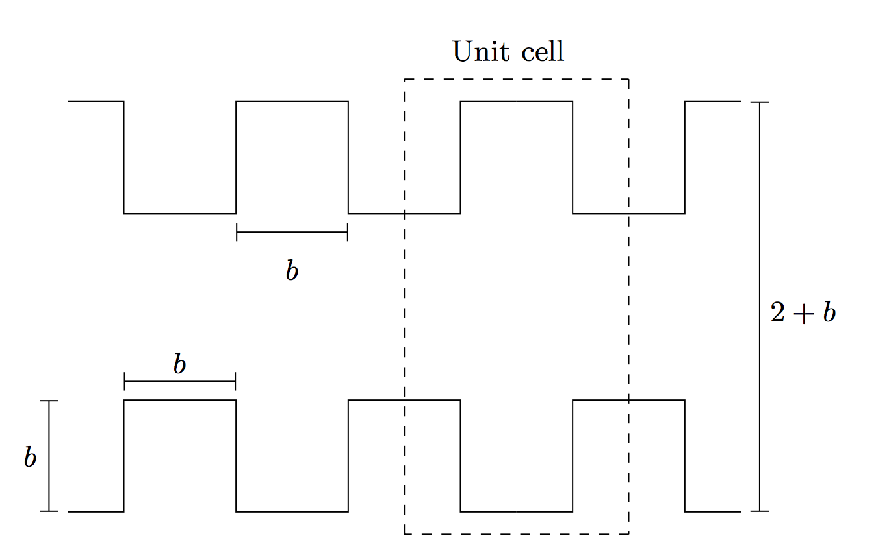
Effective diffusion in channel with periodic discontinuous wall roughness
Finite element for å finne hastighetsfelt
Bruker dette til å løse Brenner-likningen
Sammenlikner med RW-simulering

Slide 14
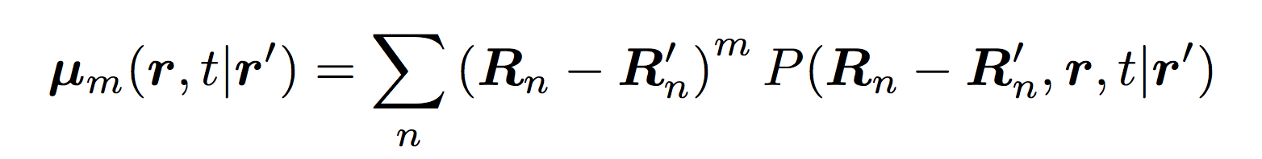
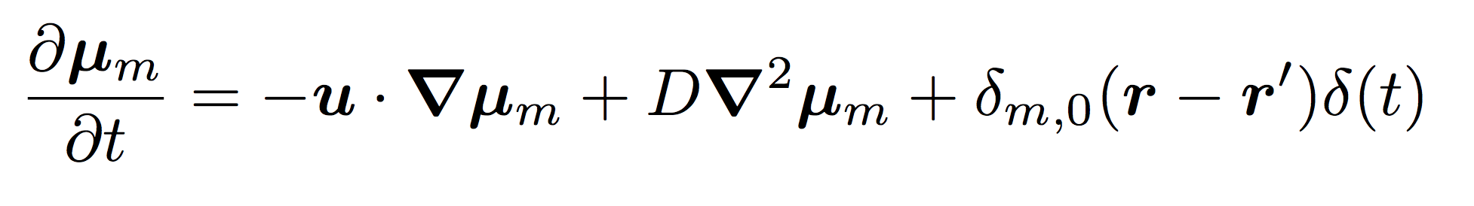
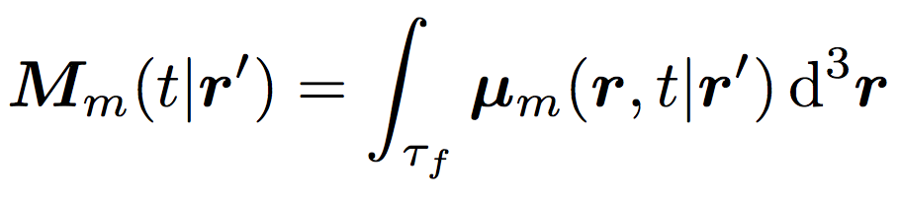
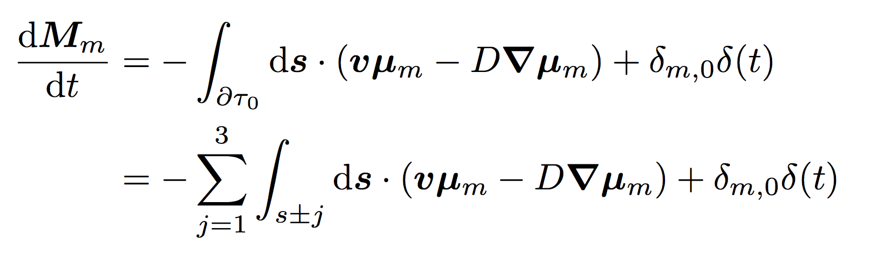
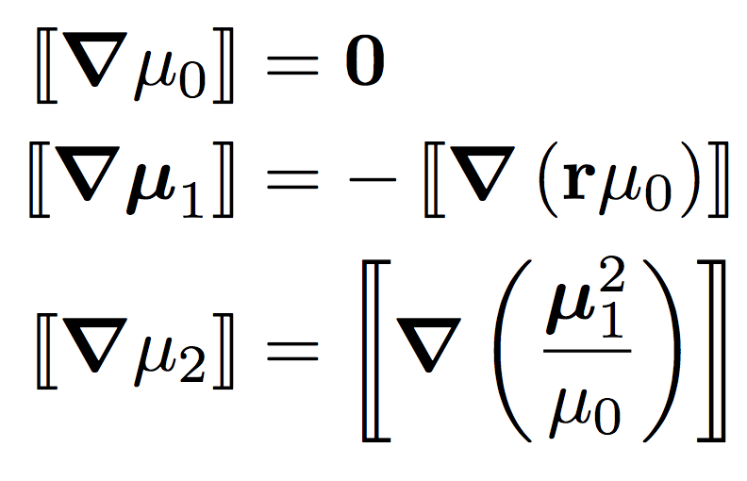
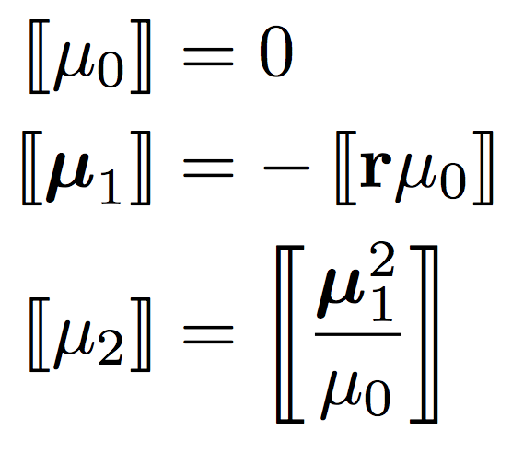
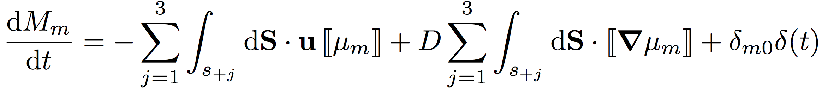
Brenner Theory

Slide 15
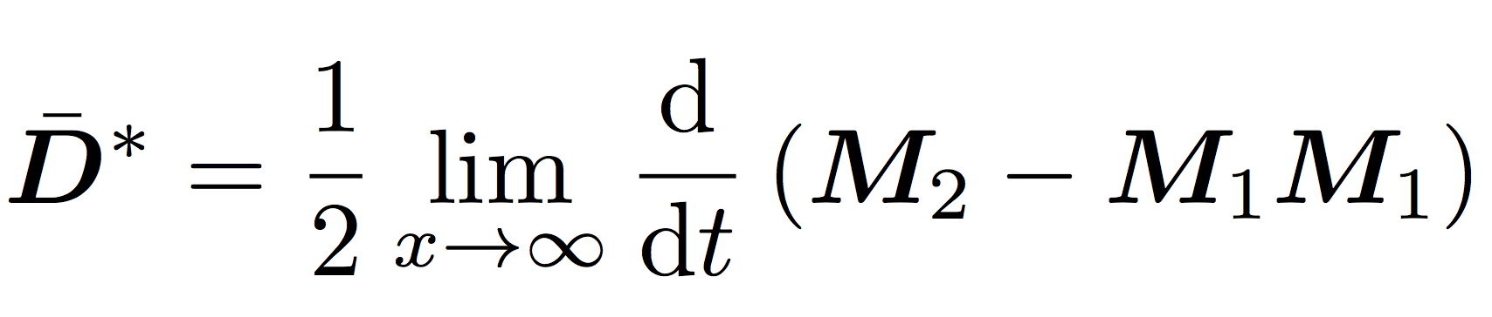
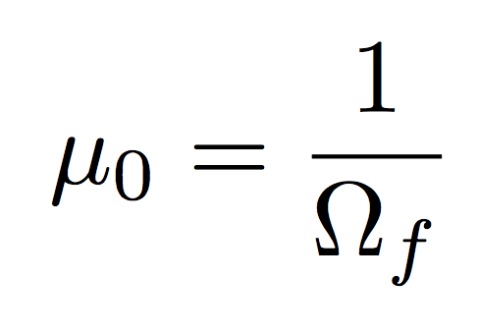
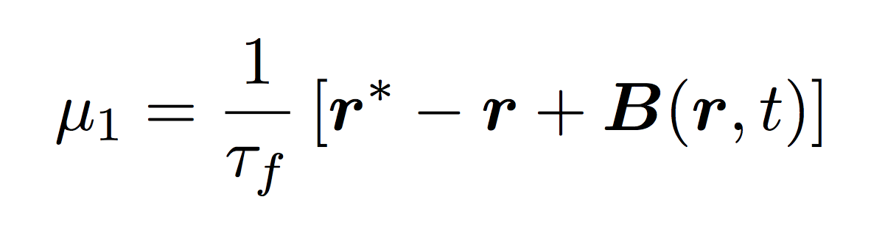
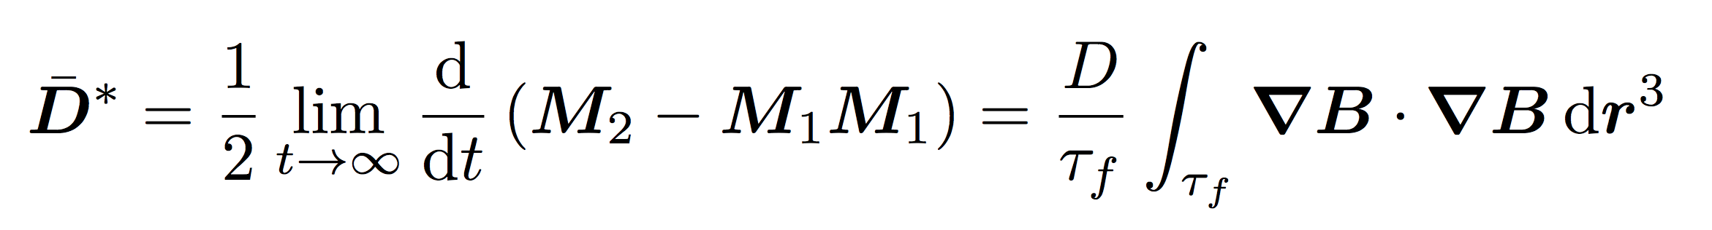
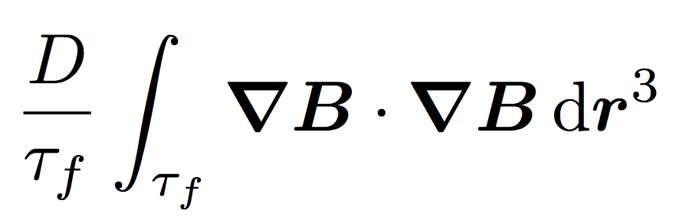
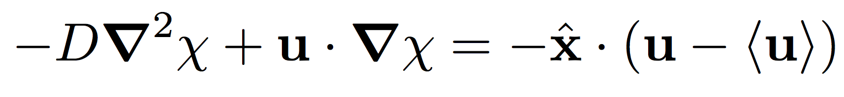
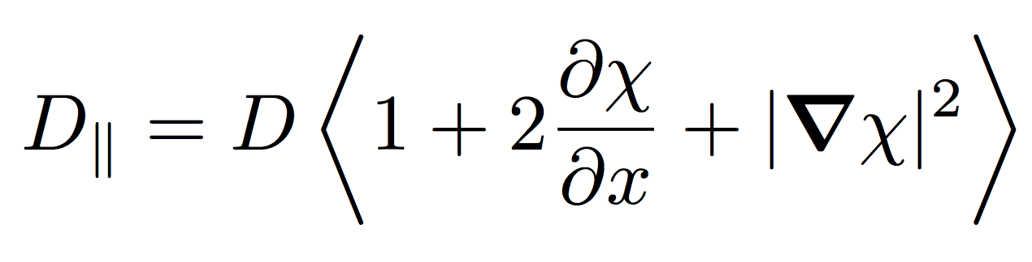
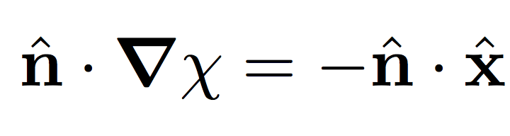
Brenner Theory

Slide 16
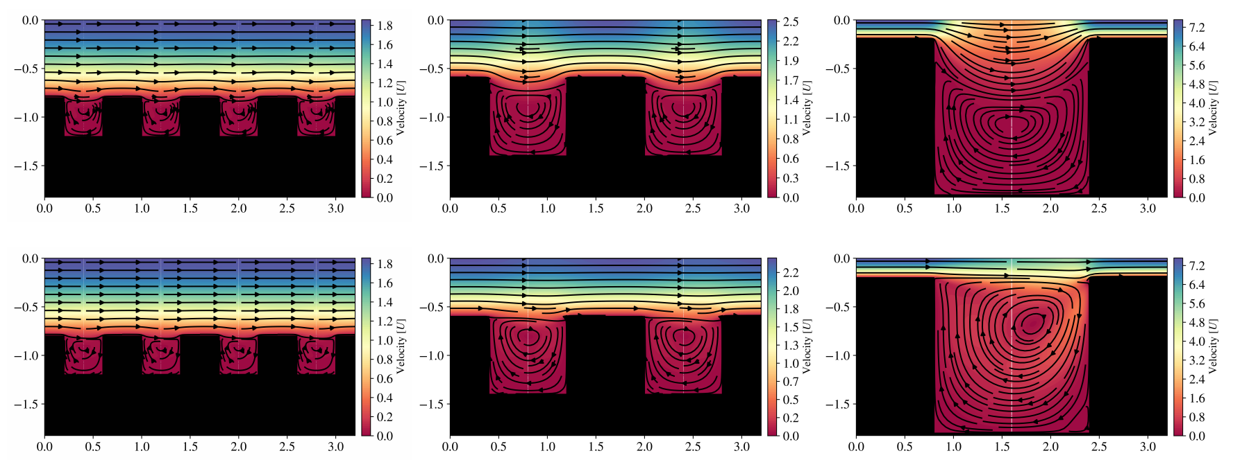
Flow field

Slide 17
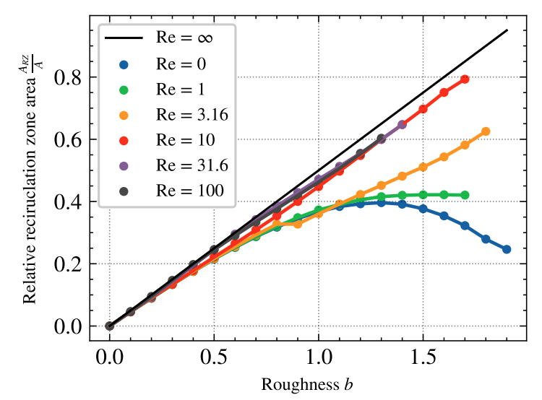
Flow field

Slide 18
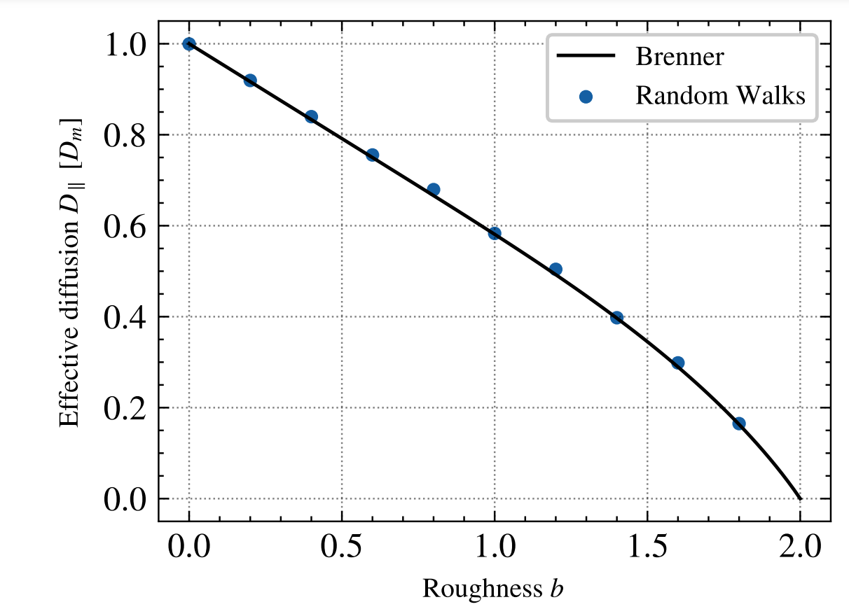
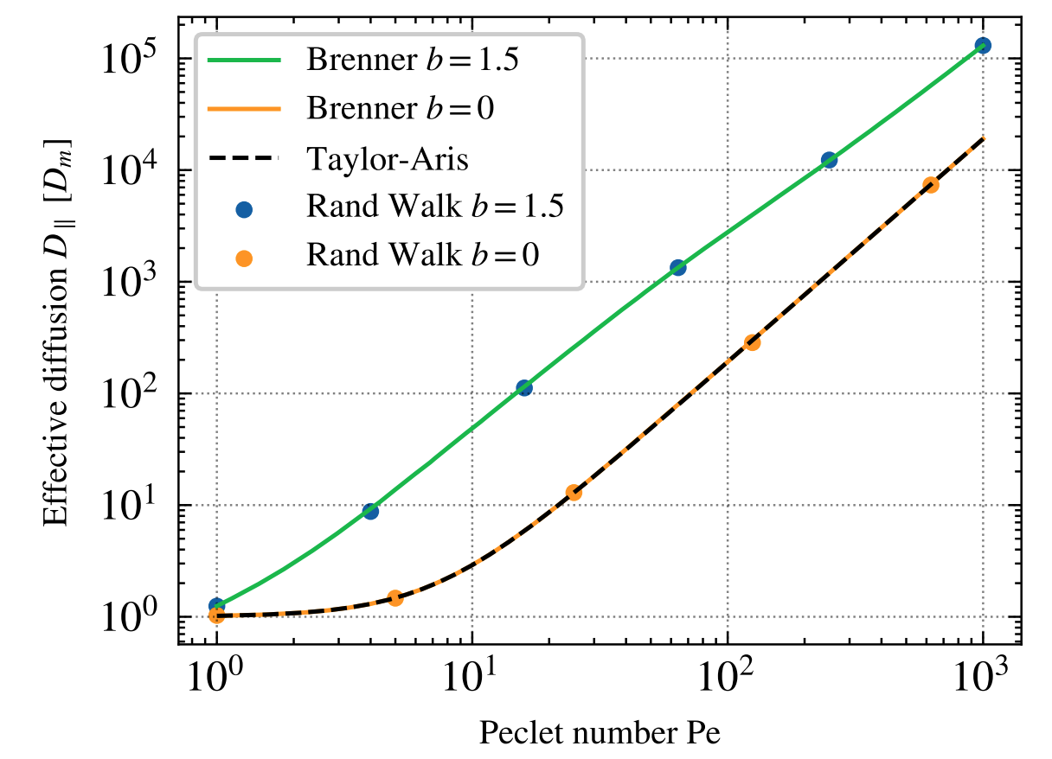
Benchmarking

Slide 19
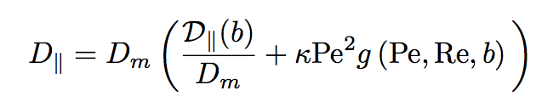
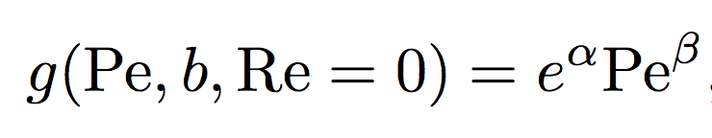
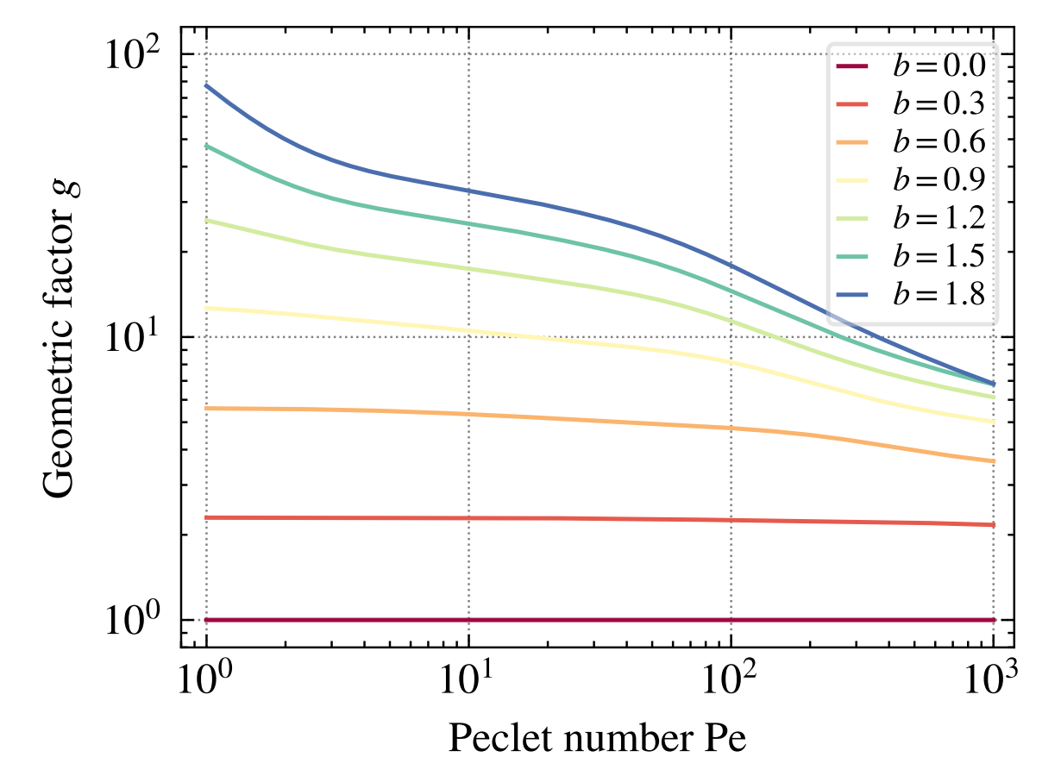
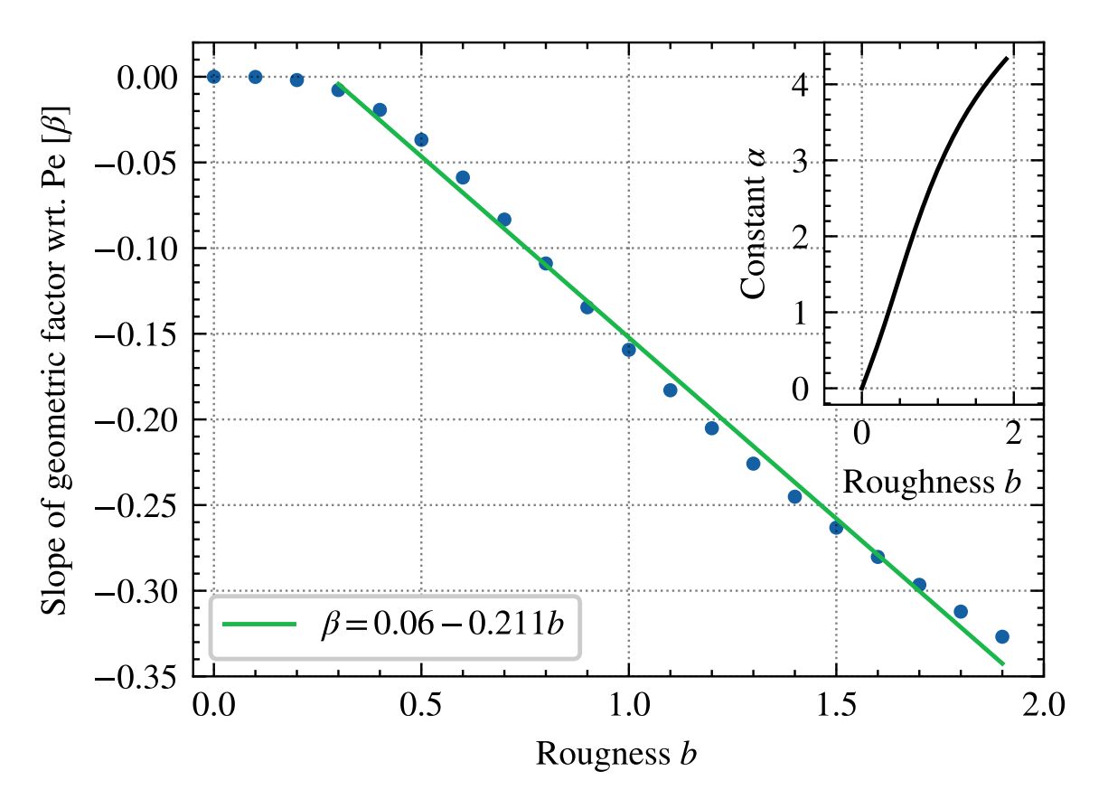
Zero Reynolds

Slide 20
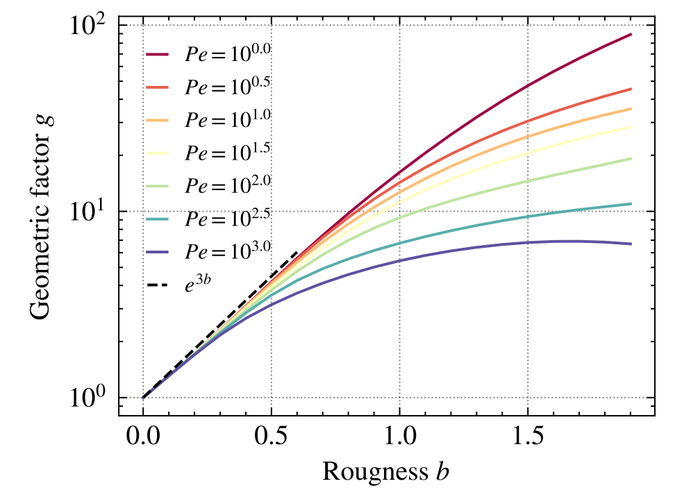

Slide 21
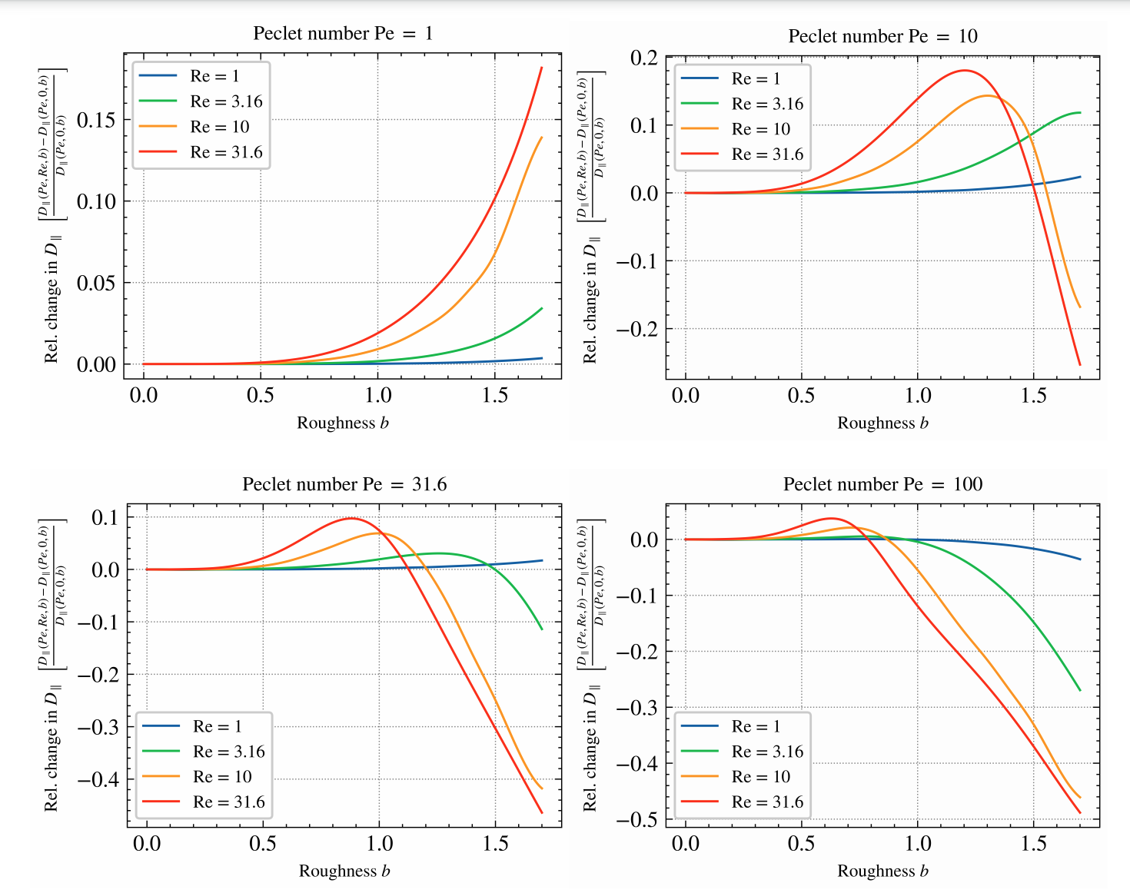

Slide 22
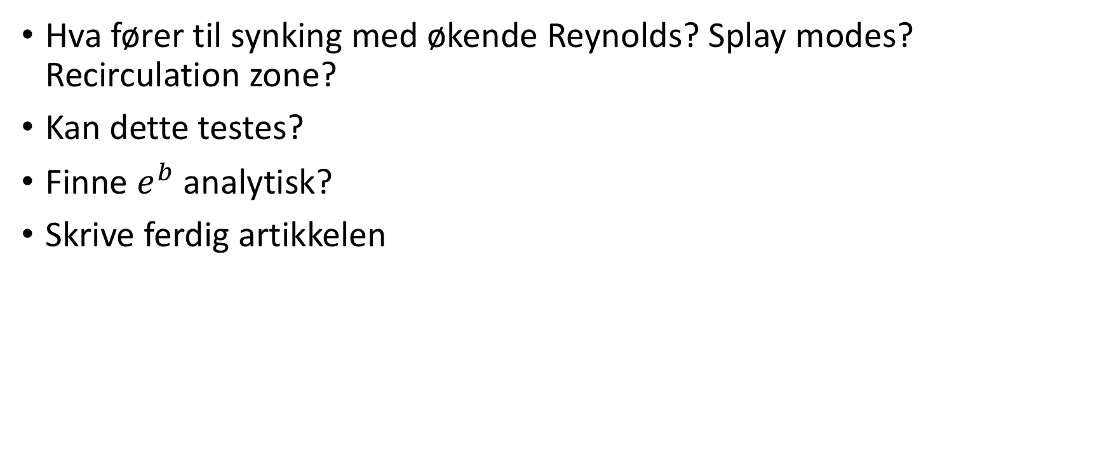
Veien videre
Hva fører til synking med økende Reynolds? Splay modes? Recirculation zone?
Kan dette testes?
Finne $e^{b}$analytisk?
Skrive ferdig artikkelen

Slide 23
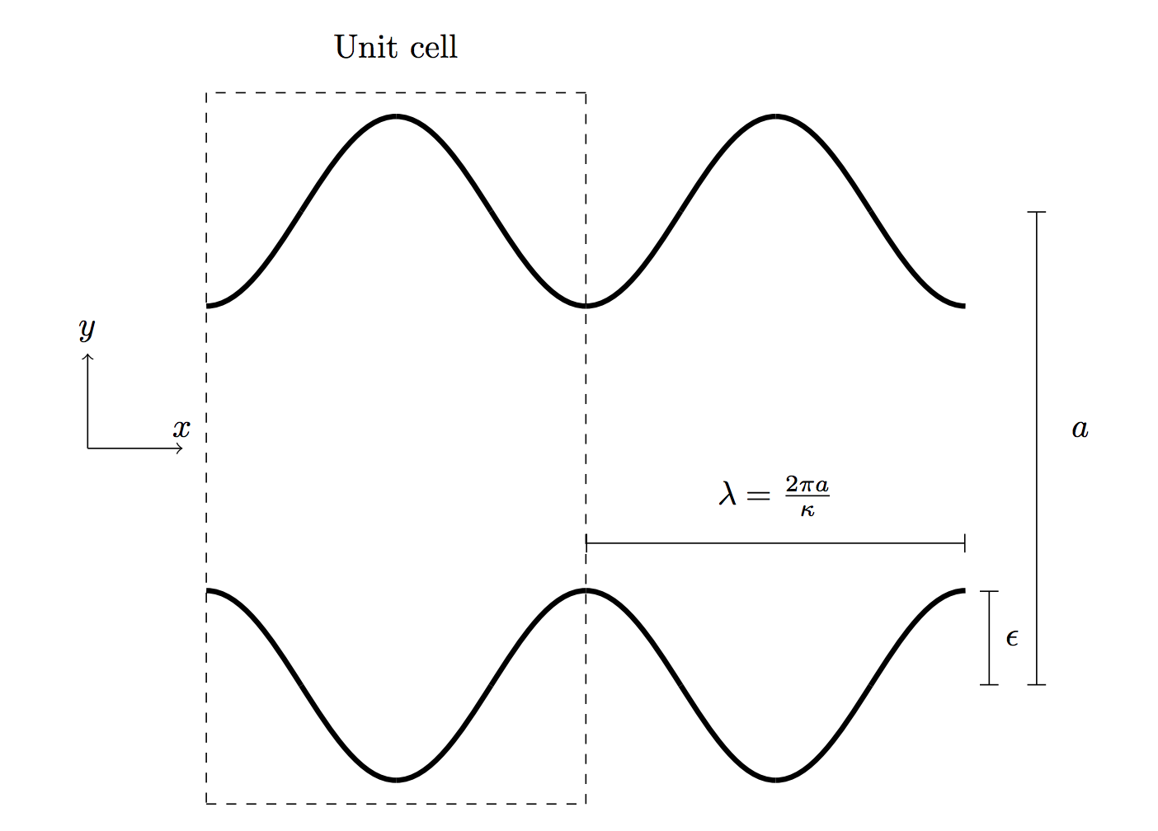
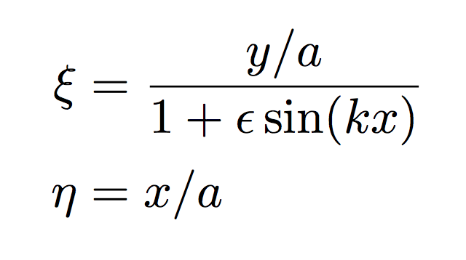




Effective diffusion for oscillating flow with periodic sinusoidal wall perturbation
Pertubasjon i epsilon
Løse NS og Brenner
Finite Element

Slide 24





Zeroth order solution

Slide 25




Zeroth order dispersion

Slide 26




First order flow solution

Slide 27




Second order flow solution

Slide 28


Slide 29



Comparison numeric and analytic velocity field

Slide 30





First order Brenner solution

Slide 31




First order Brenner solution

Slide 32




Finite element to solve first order Brenner

Slide 33



Benchmarking of finite-element

Slide 34

First order Brenner solution

Slide 35


Brenner field contribution to dispersion

Slide 36


Brenner field contribution to dispersion

Slide 37






Second order Brenner solution

Slide 38

Second order Brenner solution

Slide 39


Second order parallel diffusion coefficient

Slide 40

Veien videre
Teste mot RW og Brenner-løser
Hvor godt funker approksimasjonene? Hvor stor epsilon, kappa og Re kan man ha?
Ekspandere i små kappa (og gamma)
Boundary layer theory for $B^{(1)}$
Se om man kan få flere overtoner
Forklare »resonans»?

Slide 41
Maximizing concentration

Slide 42


Maximizing concentration

Slide 43

Maximizing concentration
Pe = 150,
Different injection methods optimalize the consentration profile for different Peclet numbers
Pe = 30

Slide 44


Variance of concentration
Pe = 150
Pe = 50
Just a property of the geometry. The consentration peak does not occur when the variance is reduced.
The behaviour is similar independent of injection method.

